Slide 1
Control Options to Prevent Falling Objects

Slide 2
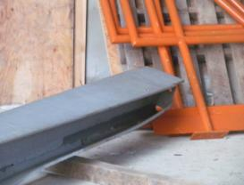
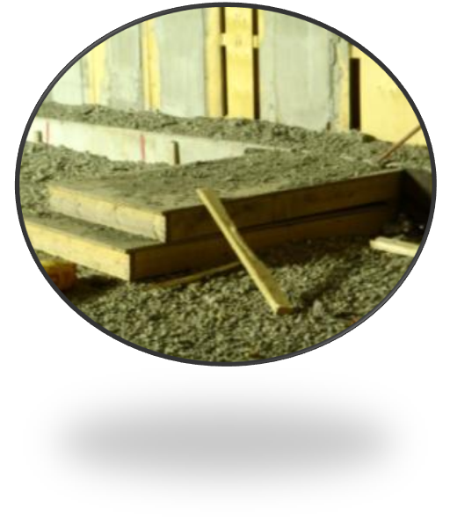
What is a falling object in the workplace?
Examples of falling objects at Mosaic include hand tools, steel beams, plywood, water bottles, impact gun, torque wrench, crane jib, PVC pipe, fiberglass panels, nuts/bolts, debris, cell phones, scaffold tubes, hardhats, etc.

Slide 3
Can the work be performed from the ground level?
The first choice of preventing falling objects is to avoid working at heights if at all possible to ELIMINATE the risk of falling objects.
If elimination is not possible, then falling object hazards must be controlled!

Slide 4
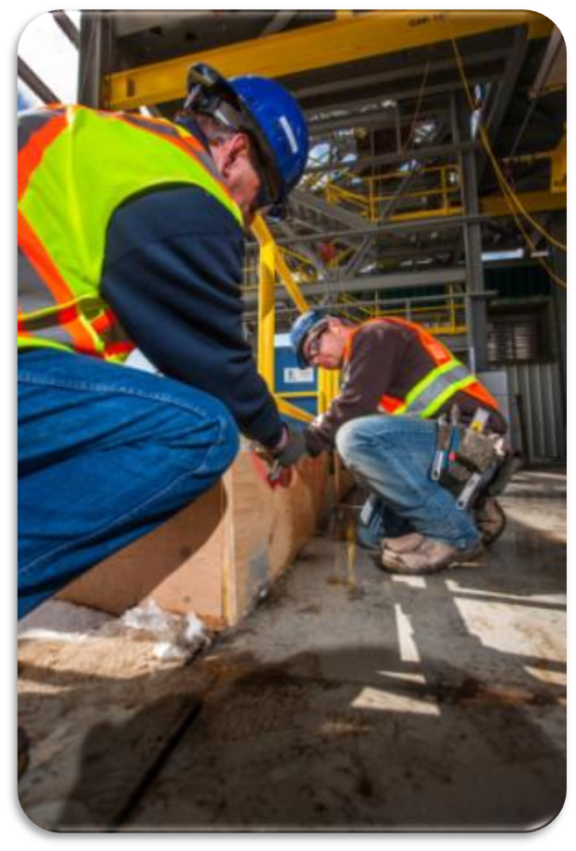
We must have controls in place to prevent falling objects when…
The method of work or the location of the work creates a falling object hazard; and
Existing engineering controls will not prevent falling objects; and
Persons may enter the active area below the overhead work.

Slide 5
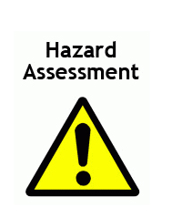
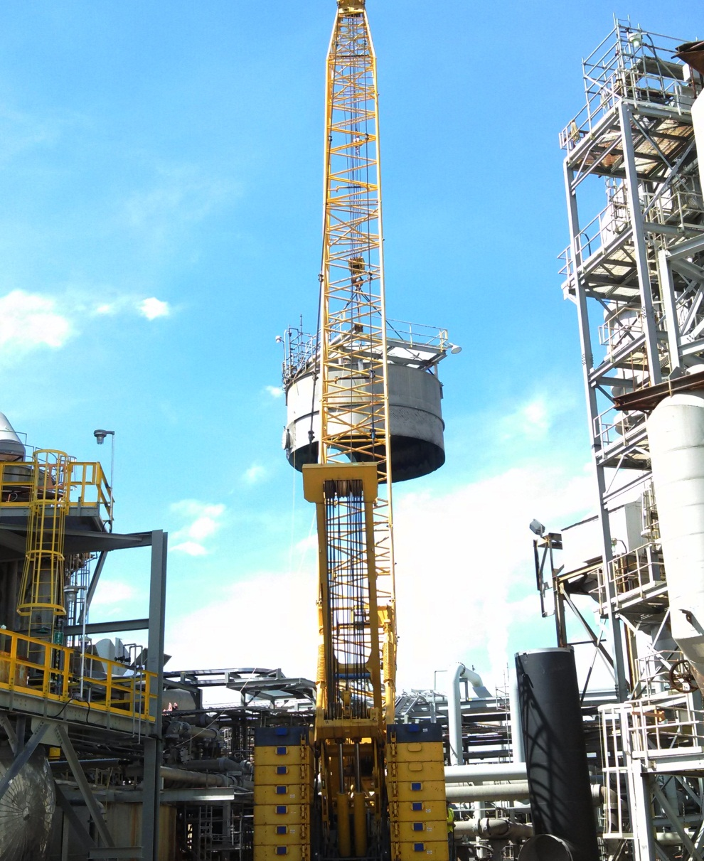
THE FIRST STEP is to perform a pre-task hazard assessment so you can identify the falling object hazards and determine which controls are required to prevent falling objects in the workplace.

Slide 6
Pre-Task Hazard Assessment
Shall be completed PRIOR to performing overhead work that creates the potential for falling objects.
Shall also evaluate the potential for “creating unsecure” falling objects for those tasks where employees/contractors unfasten, un-bolt, remove something, or cause something to become loose where it can immediately or later fall.
Shall provide the consequences and likelihood of injury/damage from falling objects to define the appropriate layer(s) of controls.
Warning: A new risk assessment shall be completed whenever conditions change and the layer(s) of controls are no longer sufficient.

Slide 7
General Rules to prevent falling objects include:
Good housekeeping is required at all times while working at heights.
When fabricating or assembling equipment, first evaluate the ability to move the work to the ground floor.
Try to keep all larger equipment at ground level whenever possible.

Slide 8
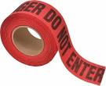
Barricades
Barricades may be used to create exclusion zones for work performed at heights that create a falling object hazard.
Special consideration must be given to the potential for objects to bounce, rebound or be blown while falling when deciding upon the size and limits of the barricade…remember objects don’t just fall straight down!

Slide 9
There are 3 levels of potential falling object risks (Low, Medium, High):
LOW Risk – Overhead work area is above remote area where NO employees/contractors are normally expected to be present.
MEDIUM Risk – An exclusion zone can be created underneath the elevated work area that can be STRICTLY ENFORCED.
Notice: Strictly enforced barricade is a physical fence barricade to block entry or barricade with a dedicated attendant that has radio/verbal contact with the overhead workers.
HIGH Risk – Exclusion zone cannot be created and workers are below or in close proximity to elevated work area.
Notice: Close proximity is determined by pre-task hazard assessment.

Slide 10
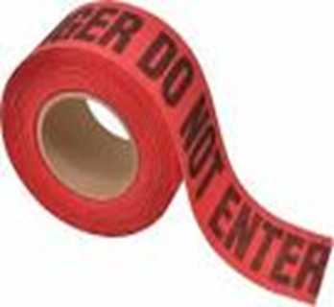
Standard Barricade
Standard barricades may be used alone as a single level of protection ONLY when the overhead work area is above a remote area where NO employees/contractors are normally expected to be present.
(Low Risk)
Standard Barricade ONLY Required
Notice: Barricades are a REACTIVE controls to prevent being struck by objects that have already fallen or dropped…

Slide 11
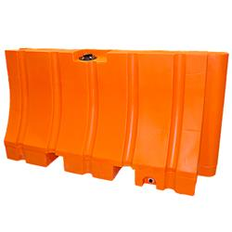
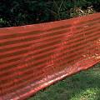
STRICTLY ENFORCED Barricades
When workers “could” possibly enter under the elevated work area, then the entire exclusion zone underneath the elevated work area shall have barricades that are STRICTLY ENFORCED:
(Medium Risk)
STRICTLY ENFORCED Barricade is Required
Physical fence barricade to block entry
or
Barricade with a dedicated attendant that has radio/verbal contact with overhead workers

Slide 12
STRICTLY ENFORCED Barricade is Required here…
Turnaround example at Bartow where barricade is inadequate and workers could possibly enter under the aerial lift…
A STRICTLY ENFORCED barricade is required here…

Slide 13
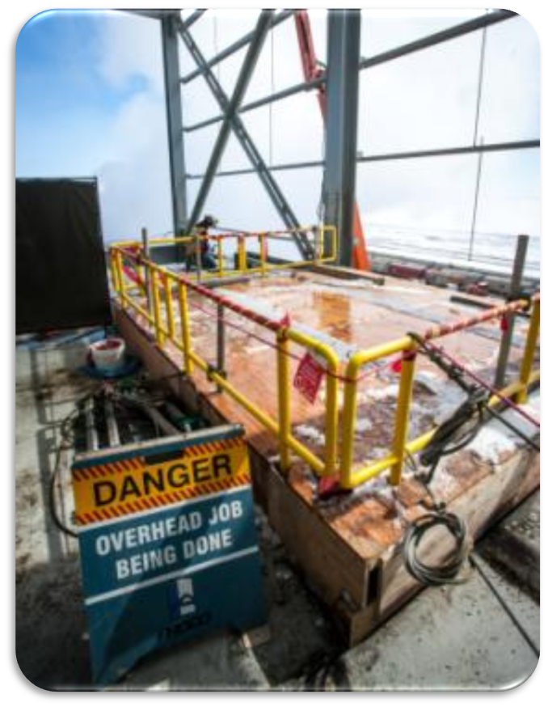
Entry into Barricades without approval is PROHIBITED…
Entry into a barricaded zone requires a voice confirmation approval process by the barricade attendant… who has communicated with workers above to stop work during entry into barricaded zone.
Warning: If unauthorized entry into barricade occurs, the attendant shall immediately stop all relevant overhead work.

Slide 14
Working “directly over or in close proximity” of other workers
If an exclusion zone CANNOT be created underneath elevated work area that can be STRICTLY ENFORCED and the overhead work is directly over or in close proximity of other workers, then ONE or more levels of engineering controls are required for each risk.
Notice: We will review engineering control options for various potential falling object risks.
(HIGH RISK)
ONE or More Layers of
*ENGINEERING Controls Required

Slide 15
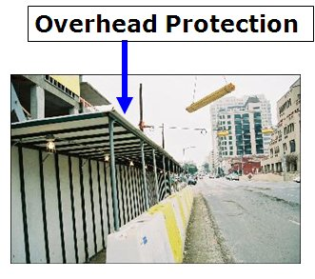
Examples of Engineering Control Options include:
Permanent Barriers
Catch Platforms/Nets
Decks/Netting/Brattice
Tool Restraints/Tethers
Covered Walkways
Securely Covered Lifting Containers
Sealed Containers for Hoisting/Lifting
Grated Floor Coverings
Tool Sleeves/Donuts
Trash Chutes
Securely Sealed Transport Containers

Slide 16
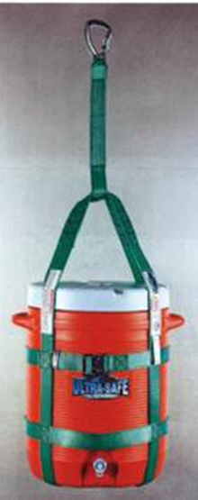
Options for Lifting/Lowering Small Objects
If you are lifting or lowering small objects, you may use securely covered lift containers.
Make sure that your covered lift containers are properly sized for the objects that you intend to lift or lower.
Know the size and weight capacity of your lift container…

Slide 17
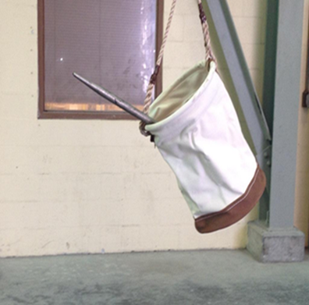
Example of INCORRECT Lifting Container…
The lifting container shown in this picture is not properly sized for the tool and it does not have a secure cover.
The spud wrench could get snagged on something during the lifting or lowering and fall out.

Slide 18
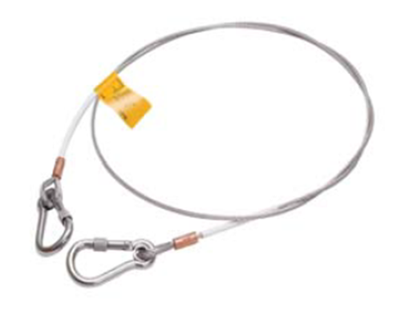
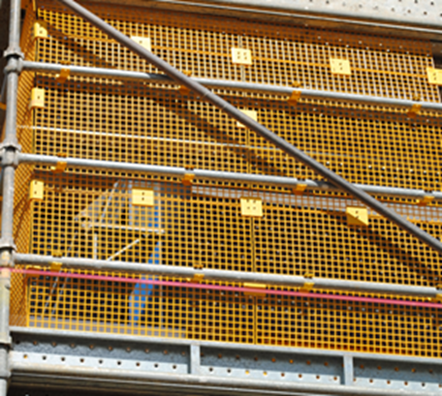
Engineering Control Options for Scaffolds and Elevated Work Platforms:
Tool restraints/tethers may be an option
OR
Catch platforms/decks/ netting/brattice may be installed on elevated work platforms and scaffolds

Slide 19
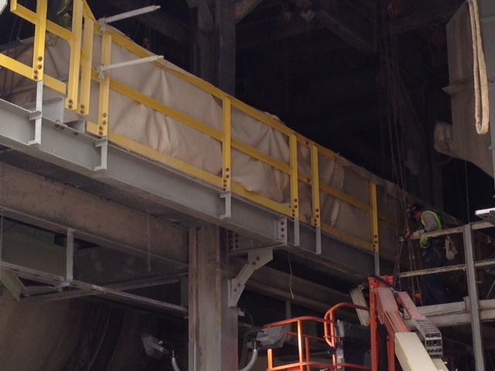
Here are some pictures of Stop the Drop control options
Solid fire blankets in use during hot work at Riverview …also prevents small objects from falling.
Netting may be used when using larger objects overhead…

Slide 20
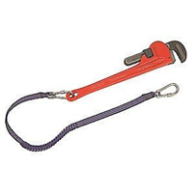
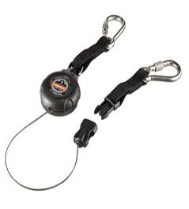
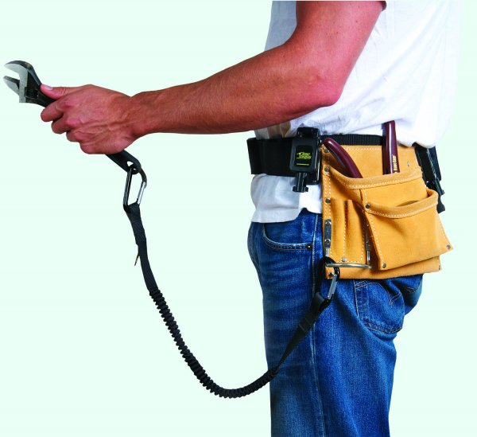
Here are some examples of tool tethers or lanyards:

Slide 21
WARNING: Tool tethers or lanyards shall not be used for blades, knives, etc. or around machinery and moving parts, as these risks are to be evaluated during the hazard assessment prior to starting the task.

Slide 22
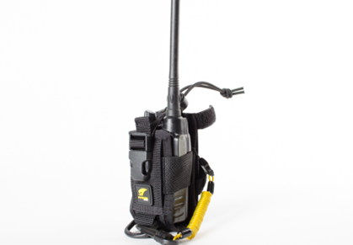
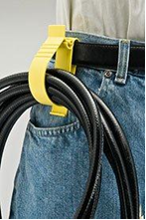
Examples of control options for securing tools or items when not in use…
Radio Holster

Slide 23
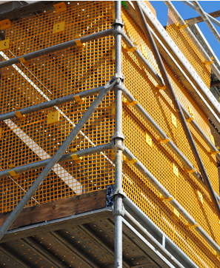
Examples of Scaffold Netting/Fencing:
Netting/Fencing must be “sized to match the risk”…for example –
solid sheeting is required when using small nuts/bolts, etc. to keep from dropping…
K3 at Esterhazy

Slide 24
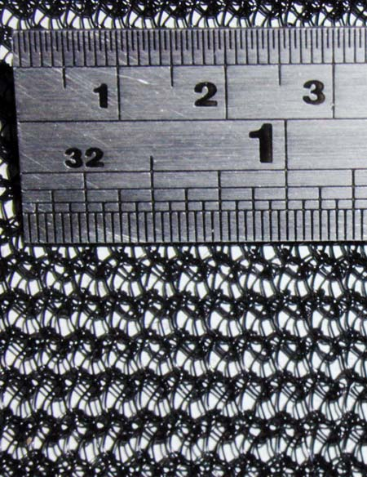
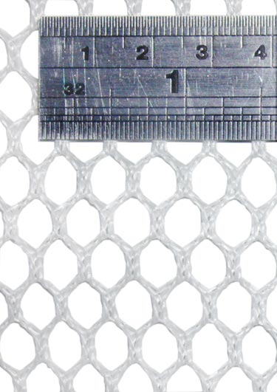
Netting/sheeting must be sized to match the potential falling object risk…

Slide 25
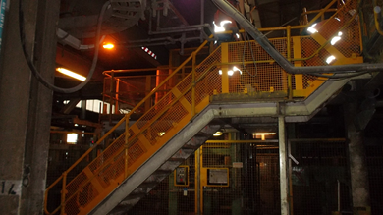
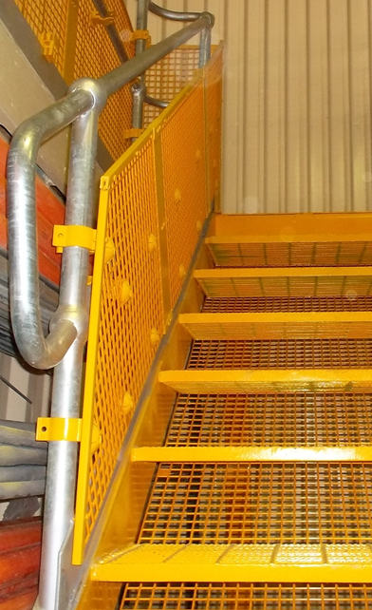
Here are examples of falling object controls on stairways that have been determined by hazard assessment to have a high risk for falling objects…

Slide 26
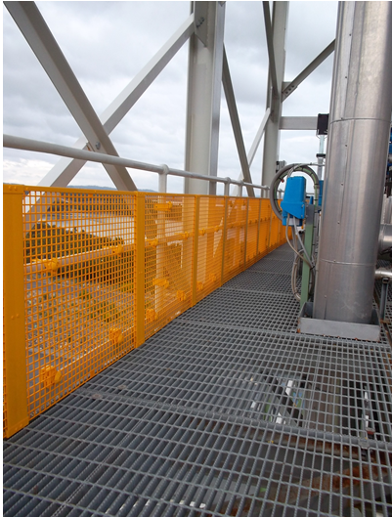
Here are more examples of netting/fencing control options to prevent falling objects…

Slide 27
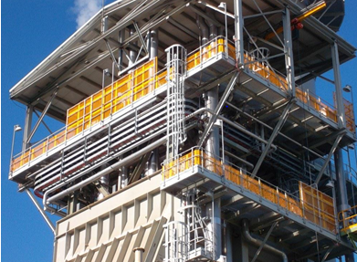
More examples of netting/fencing control options to prevent falling objects…

Slide 28
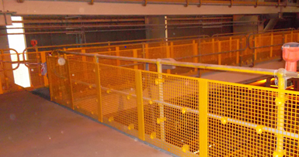
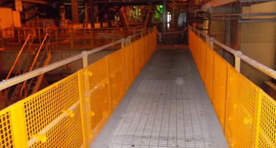
Here are some pictures of work areas with falling object protection…

Slide 29
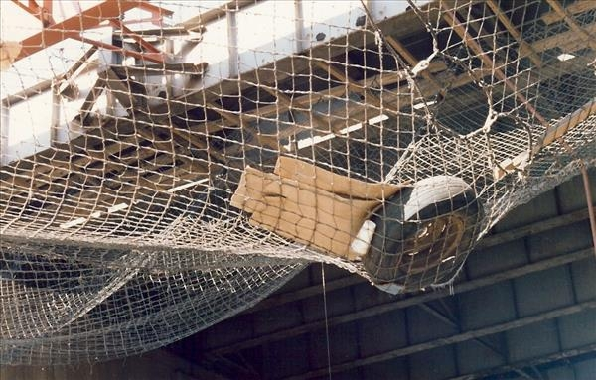
Here are examples of debris catch nets…

Slide 30
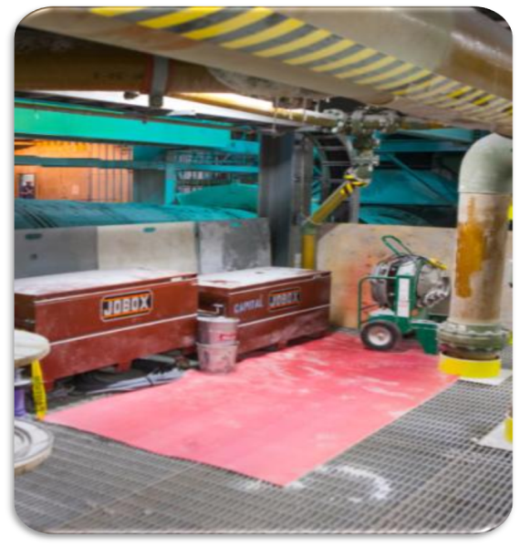
Grated Floors Control Options…
Grated floors present a hazard for falling objects when you are working with small objects that can fall through the grating.
Controls may include floor covering such as plywood, tarp, or other suitable covering.

Slide 31
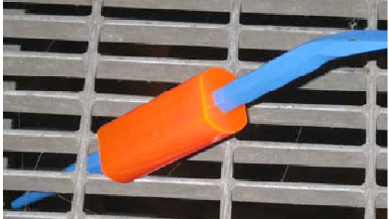
Grated Floor Controls for Tools
Grated floor controls may include tool sleeves or donuts to increase the size of tool handles and prevent them from falling through the grating.

Slide 32
Example: Grated floors are covered at Bartow to prevent sandblasting grit from falling through grating…

Slide 33
Hot Work
When you are preparing to perform hot work, you must position decking, mats, fire blankets, etc. to prevent falling objects such as sparks or slag…

Slide 34
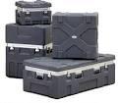
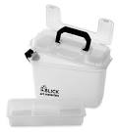
Tool and Material Storage Options
Tools and materials may be stored in securely covered tool buckets or containers when not in use.
Notice: Place tool containers away from the edges of the work platform.

Slide 35
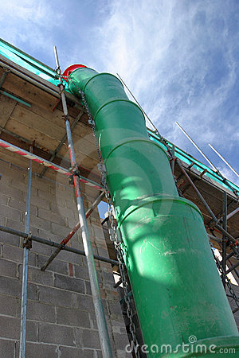
When you are moving trash/debris to a lower level…
You may use chutes
OR
solid containers that are designed for hoisting or lifting debris with an effective means of sealing when placing debris into a work area below.

Slide 36
Engineering Control Determination
ONE layer of engineering control must cover each potential falling object risk(s):
For Example: –
If the following TWO potential falling object risks are identified:
dropping tools and
nuts/bolts falling through floor grating
Then grated floor covering plus tool tethers are engineering control options (one engineering control per risk).

Slide 37
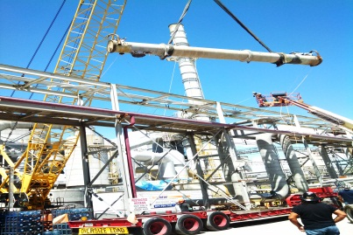
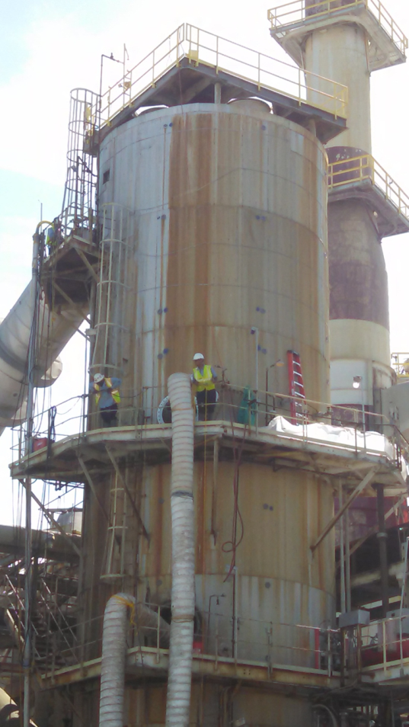
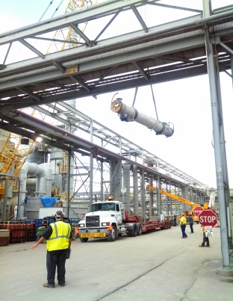
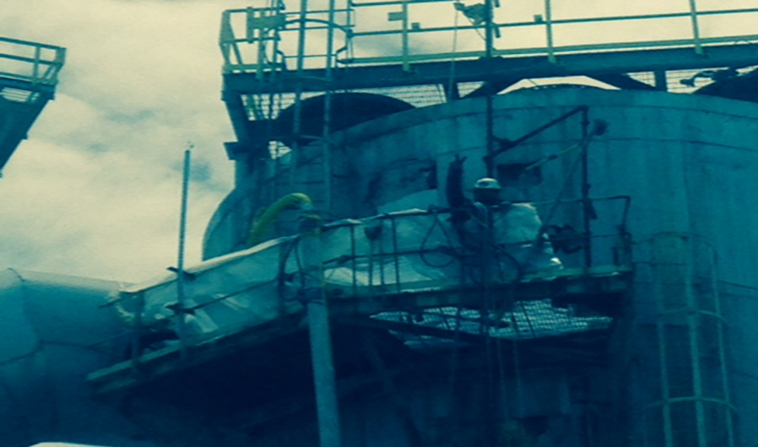
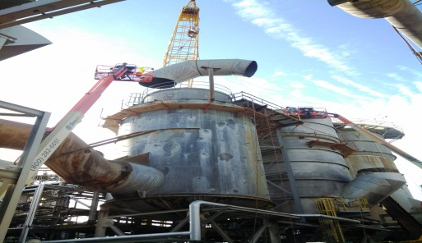
Turnarounds or Construction
Due to the high potential for falling object hazards during turnarounds or construction, daily inspections must be conducted for potential falling object hazards.

Slide 38
How does Mosaic ensure that we are in compliance with the Stop the Drop program?
Field safety audits are conducted on a regular basis to ensure compliance with this program.
All overhead work associated with the work permit must STOP until any deficiencies identified in the field safety audit are corrected.

